Slide 1
Wilkinson Power Divider Simulation
Xinhang Xu
10/5/2025

Slide 2
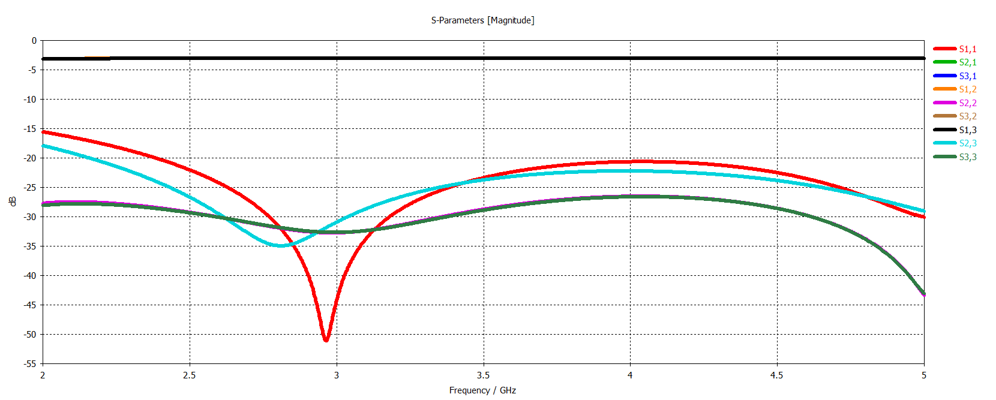
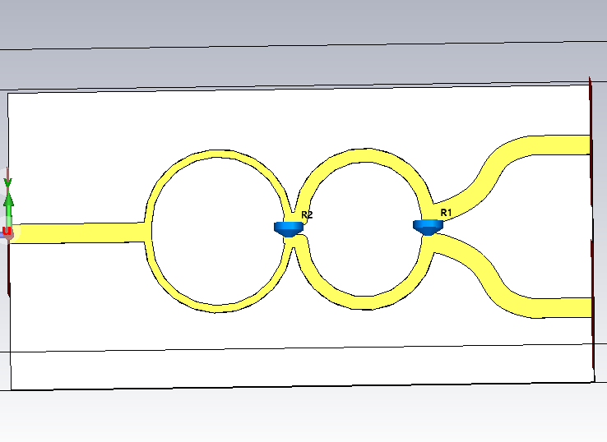
F = [2 5] GHz

Slide 3
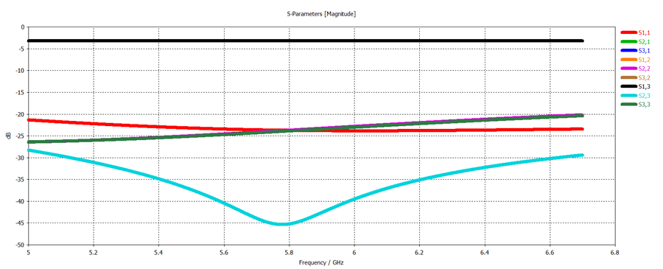
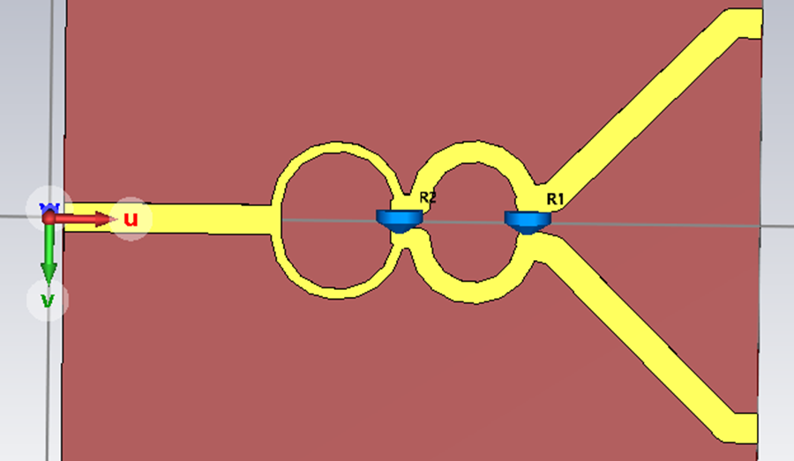
F = [5 6.7] GHz

Slide 4
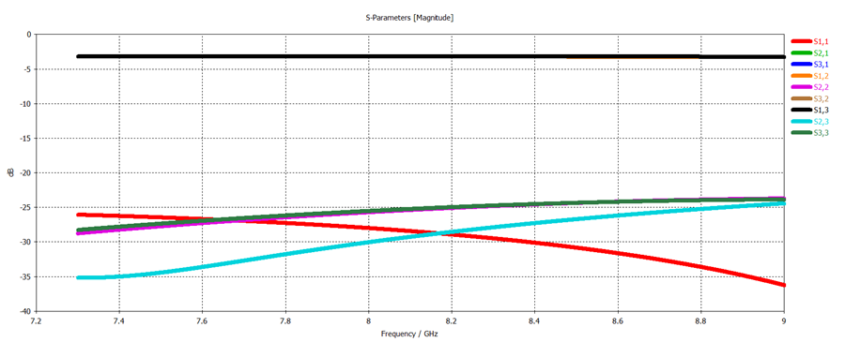
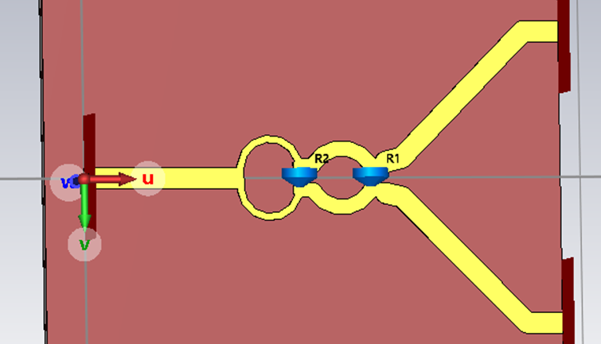
F = [7.3 9] GHz

Slide 5
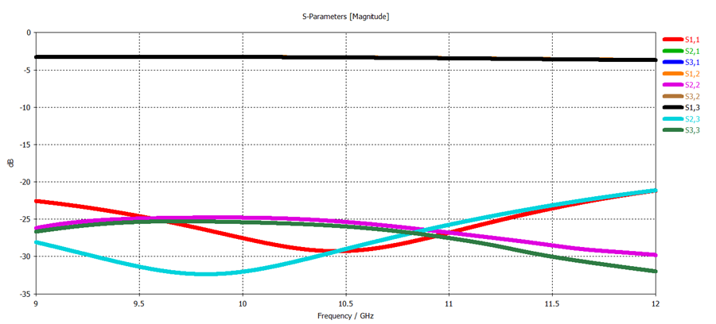
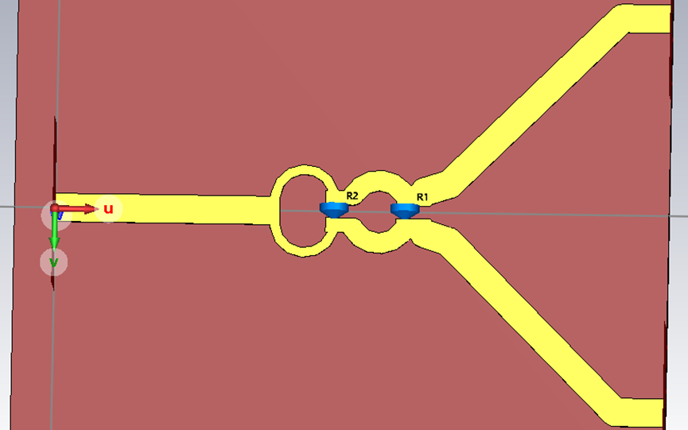
F = [9 12] GHz

Slide 6
NSF WPD

Slide 7
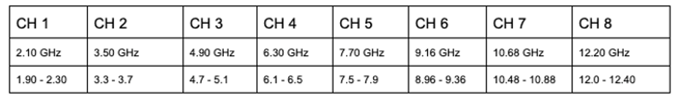
1.90
WPD3
WPD1 : 1.9 – 6.5 GHz,4 rings
WPD3 : 1.9 – 3.7 GHz,2 rings WPD4: 4.7 – 6.5 GHz,2 rings
WPD2 : 7.5 – 12.40GHz,4 rings
WPD5 : 7.5 – 9.36 GHz,2 rings
WPD6 : 10.36 – 12.40 GHz,2 rings
WPD1
3.7
4.7
WPD4
Commercial
6.5
7.5
Coco: WPD3,WPD4,WPD2
WPD5
WPD2
9.36
10.48
WPD6
12.40

Slide 8
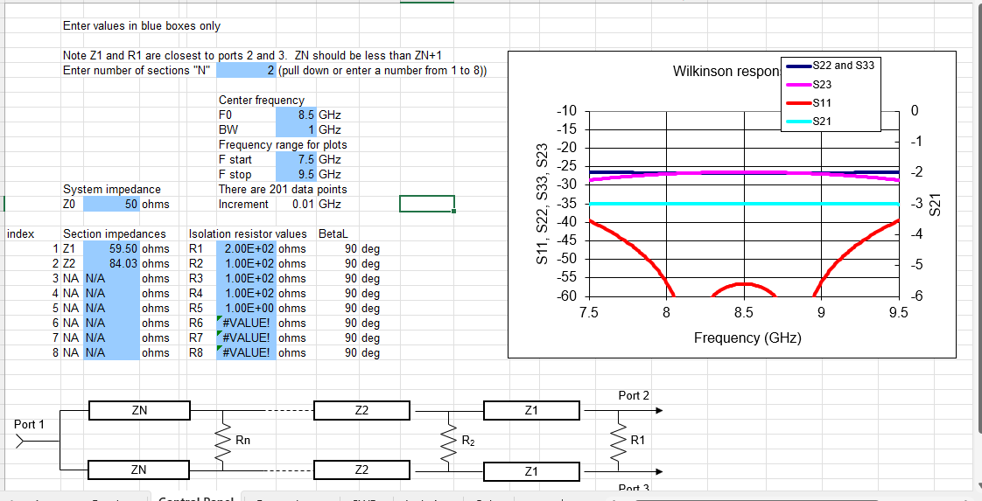
WPD5:7.5-9.5 GHz
Z | W(mil) | L(90 degree)
59.5 | 30.83 | 208.25
84.03 | 14.39 | 213.23
50 | 42 | **

Slide 9
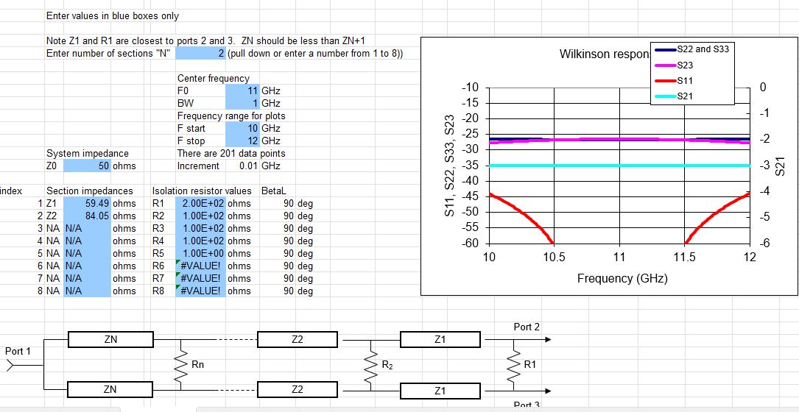
WPD6:10-12 GHz
Z | W(mil) | L(90 degree)
59.5 | 30.83 | 208.25
84.03 | 14.39 | 213.23
50 | 42 | **

Slide 10
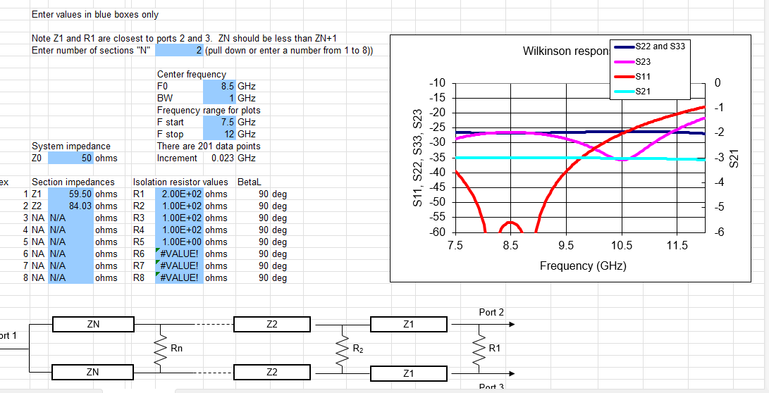

Slide 11
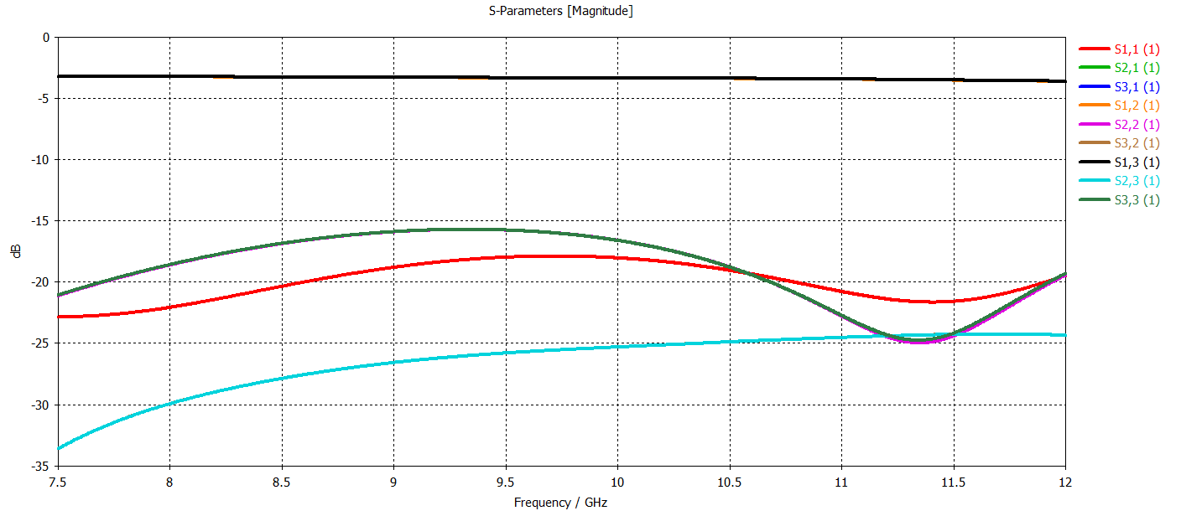
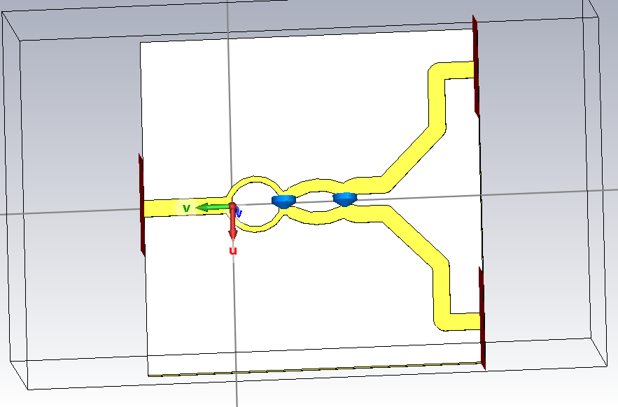
WPD5:7.5-9.5 GHz

Slide 12
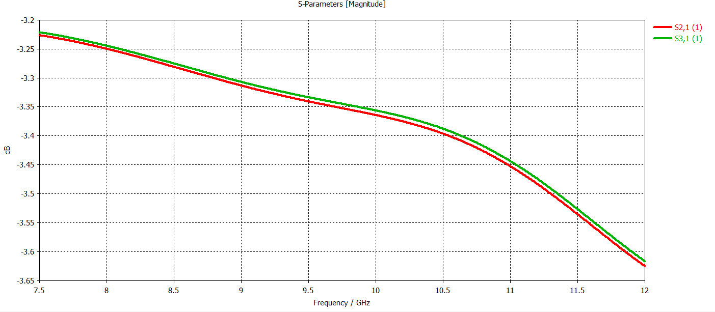
WPD5:7.5-9.5 GHz

Slide 13
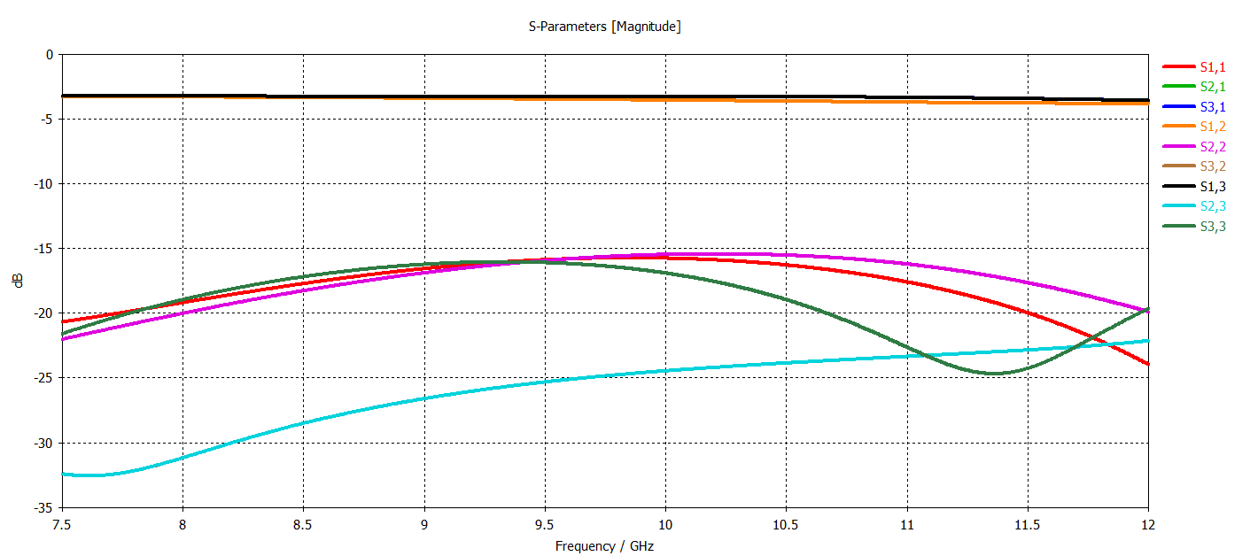
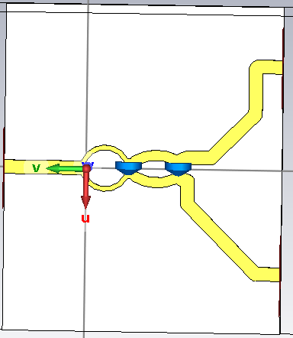

Slide 14
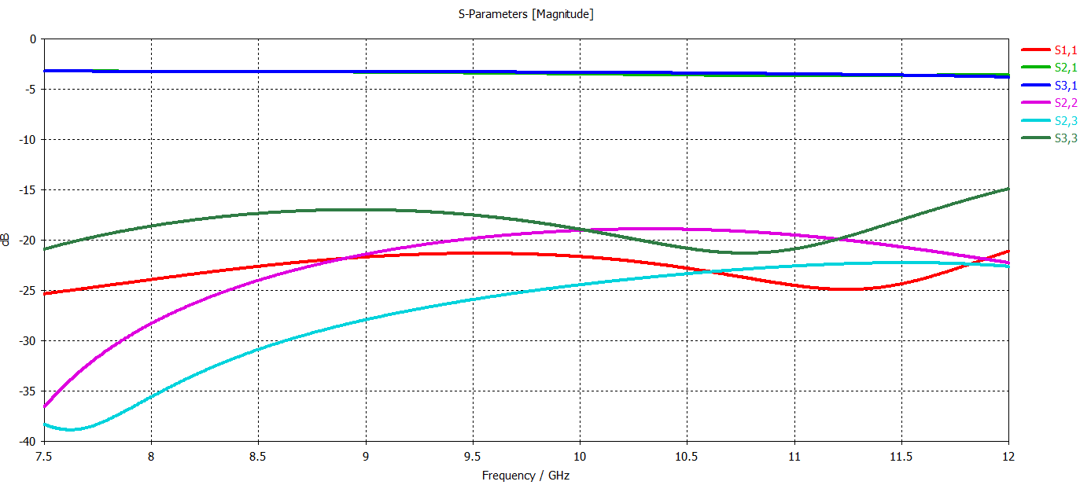
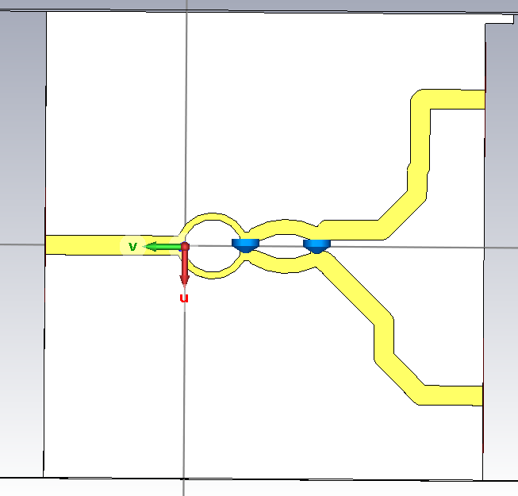
Wpd5_v3_output_port

Slide 15
